Slide 1
I2Cw Log
06/08/2023
Brandon Beader

Slide 2
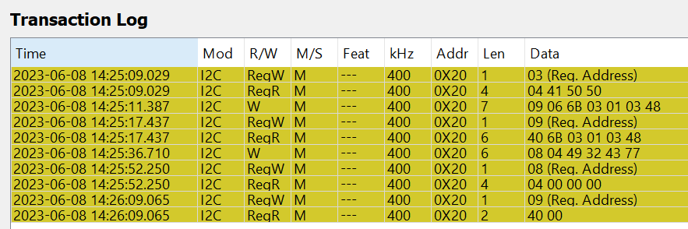
Full 4CC Transaction Log

Slide 3
Read register 0x03
04 41 50 50 -> APP

Slide 4
# of bytes of data being written
Slave Address
Register Offset
Data Being written
# of bytes
Write to register 0x09 (DATA1)

Slide 5
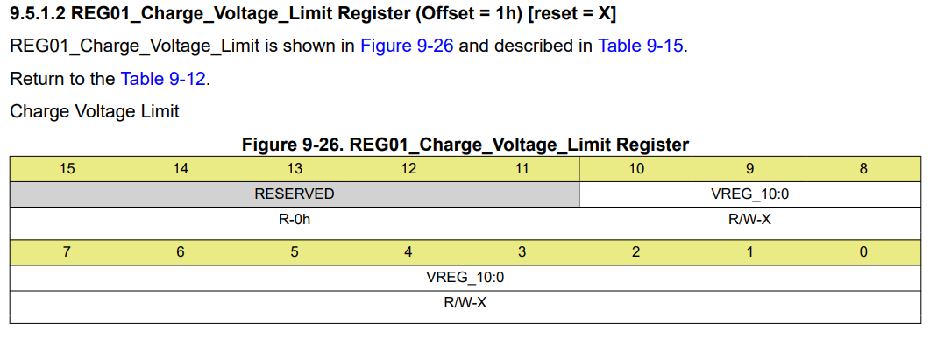
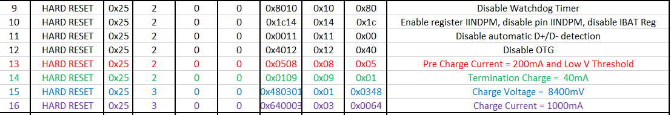
BQ Register
The I2Cw transaction is for 2S battery configuration, therefore we are writing 03 48 to register 01h.
This correlates to Charge Voltage 8400mV
Register
Data

Slide 6
Read register 0x09 (DATA1)
Ensure data matches that was written in previous step

Slide 7
4CC command
49 32 43 77 -> I2Cw
Write to register 0x08 (CMD1)
# of bytes

Slide 8
Read register 0x08 (CMD1)
Ensure 00’s -> Task Executed
# of bytes = 04 from 4CC
00’s

Slide 9
Read register 0x09 (DATA1)
Ensure 00’s -> Task Executed
# of bytes = 04 from 4CC
00’s

